Slide 1
Database Design Fundamentals
DV6E 34

Slide 2
Topics/Outline
Database – Definition, Types, Terminologies, concepts, classes & examples
Flat Files
Relational Database Management System (RDBMS)
E-R Model Systems
Normalisation
SQL – Introduction, queries,
Creating Database (simple - excel & structured - RDMS)
Basic Operations (DB interrogation, data acquisition, modification, normalisation, manipulation….)

Slide 3
Part. C: Relational Database Management System (RDBMS)

Slide 4
What is Database Management System (DBMS)?
Software tools that enable the management (definition, creation, maintenance and use) of large amount of interrelated data stored in a computer accessible media.
This may also refer to sets of operations performed within a typical database.
add, remove, update records
retrieve data that match certain criteria
cross-reference data in different tables
perform complex aggregate calculation
A database management system (DBMS) is a collection of programs that enable users to create and maintain a database.
DBMS is the intermediary between the user and the database (i.e. storage)
Database structure stored as file collection
Can only access files through the DBMS
According to the ANSI/SPARC DBMS Report (1977), a DBMS should be envisioned as a multi-layered system:

Slide 5
Functions & Applications of Database Management System (DBMS)
Manage persistent data
Access large amounts of data efficiently
Support for at least one data model
Support for certain high-level language that allow the user to define the structure of the data, access data, and manipulate data
Transaction management – the capability to provide correct, concurrent access to the database by many users at once
Access control – the ability to limit access to data by unauthorized users, and the ability to check the validity of data
Resiliency – the ability to recover from system failures without losing data
Allow concurrency
Control security
Maintain data integrity
Provide for backup and recovery
Control redundancy
Allow data independence
Provide non-procedural query language
Perform automatic query optimization
Data transformation and presentation
Security management
Multi-user access control
Data backup and recovery management
Data integrity management

Slide 6
Who Interacts with a DBMS?
Different individuals are involved with the operation and uses of database management system (DBMS) over its life.
Example;
Systems analysts
Database designers
Database administrators
Application developers
Data scientists
End users

Slide 7
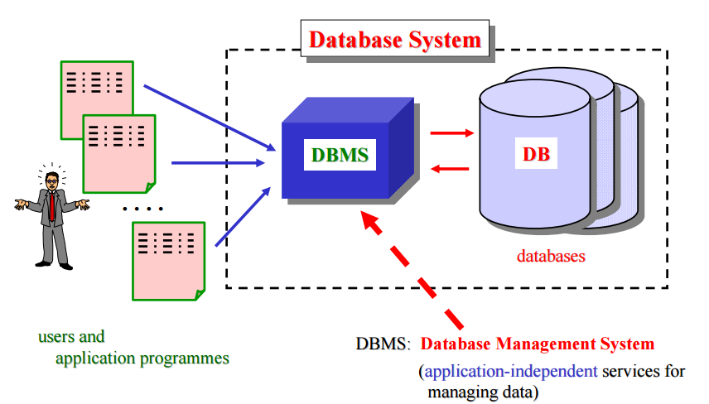
Schematic of DBMS

Slide 8
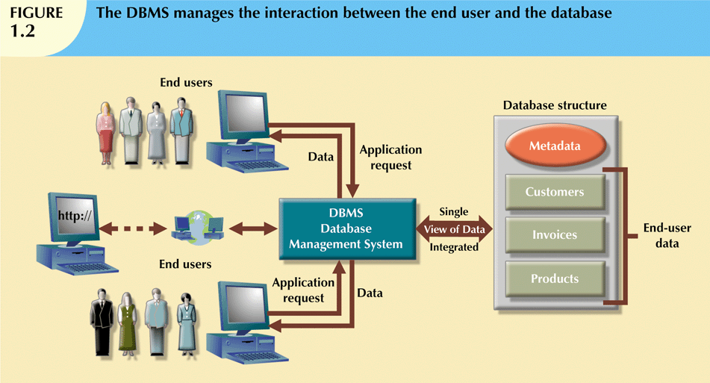
Schematic of DBMS

Slide 9
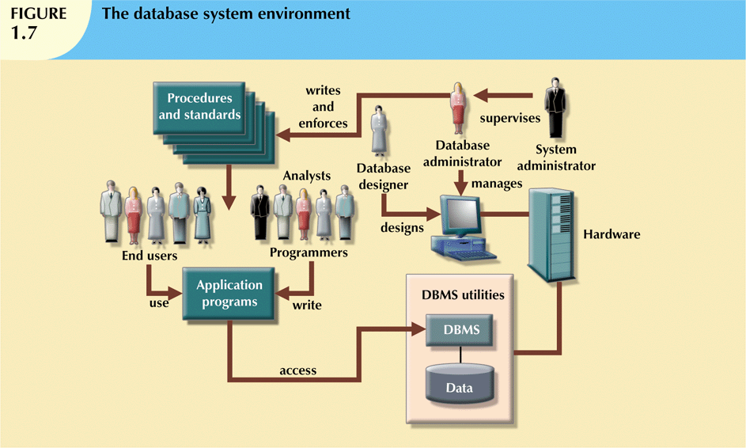
Components of a DBMS
There are five major parts that constitute a Database Management System (DBMS) components.
These include;
Hardware
Software
People/users
Procedures
Data
Tables

Slide 10
Components of a DBMS
Hardware: All the system’s physical devices
Software: Three types of software required:
Operating system software
DBMS software (e.g. Microsoft Access)
Application programs and utility software
People: All users of the database system
System and database administrators
Database designers
Systems analysts and programmers
End users
Procedures: Instructions and rules that govern the design and use of the database system
Data: The collection of facts stored in the database

Slide 11
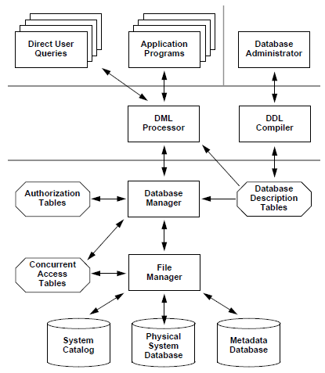
Component of a Database System

Slide 12
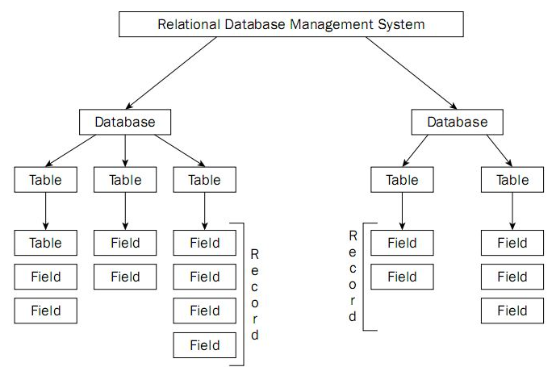
RDBMS Architecture

Slide 13
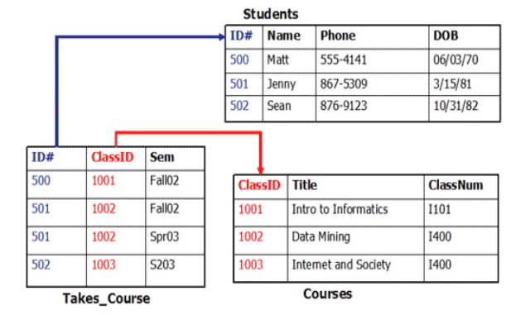
RDBMS Architecture

Slide 14
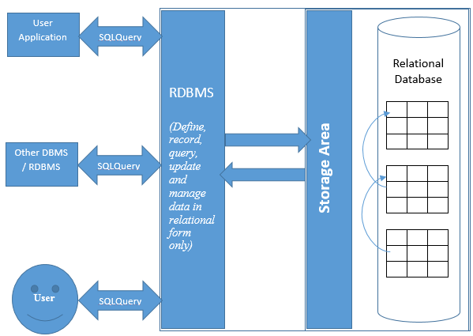
RDBMS Architecture

Slide 15
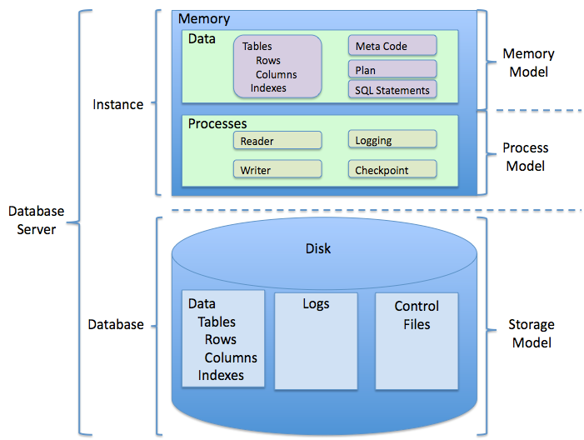
RDBMS Architecture

Slide 16
Commercial Database Management (RDBMS) Products
Microsoft (Access, SQL Server)
Oracle RDBMS
IBM (DB2, Informix)
MySQL (Freeware)
Postgres (Freeware)
Sybase

Slide 17
When Not To Use Databases
Cost of using a DBMS:
High initial investment and possible need for additional hardware.
Overhead for providing generality, security, concurrency control, recovery, and integrity functions.
When a DBMS may be unnecessary:
If the database and applications are simple, well defined, and not expected to change.
If there are stringent real-time requirements that may not be met because of DBMS overhead.
If access to data by multiple users is not required.
When no DBMS may suffice:
If the database system is not able to handle the complexity of data because of modeling limitations
If the database users need special operations not supported by the DBMS.

Slide 18
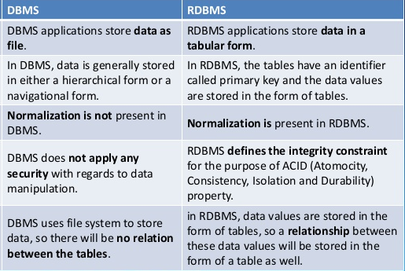
DBMS vs. RDBMS

Slide 19
DBMS & RDBMS - Summary
DBMS generally consist of database setup in which the structure consist of different data tables without any set (i.e. established) relations.
The different tables within a DBMS setup are usually non-related, i.e. they operate independently.
RDBMS may have similar architecture and setup to DBMS, but in this case the different tables within the setup must be related.
RDBMS offers a more efficient and robust platform for extending the operations and functionality of databases.

Slide 20
Resource - Links
https://www.sqa.org.uk/e-learning/DDFun01CD/index.htm

